Slide 1
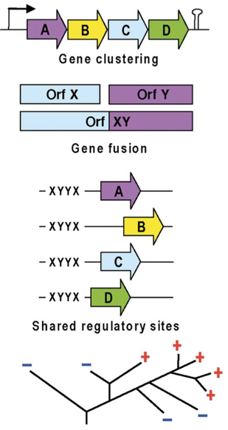
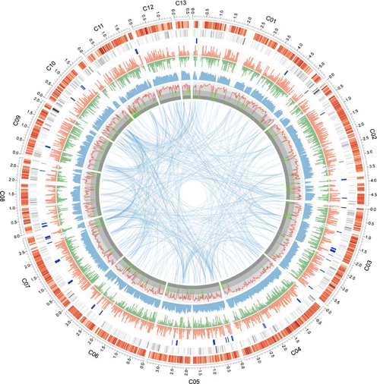
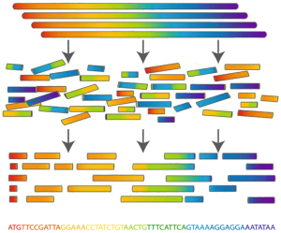
Recap 01.11.2022
Philipp Engel
Department of Fundamental Microbiology, UNIL
Assembly
Annotation
Analysis

Slide 2
Bacterial isolates from water kefir
Water kefir: A fermented, fizzy drink
Lactic acid bacteria
Yeasts
Some others
Sugars
Fermentation
Acids, alcohol
https://revolutionfermentation.com/

Slide 3
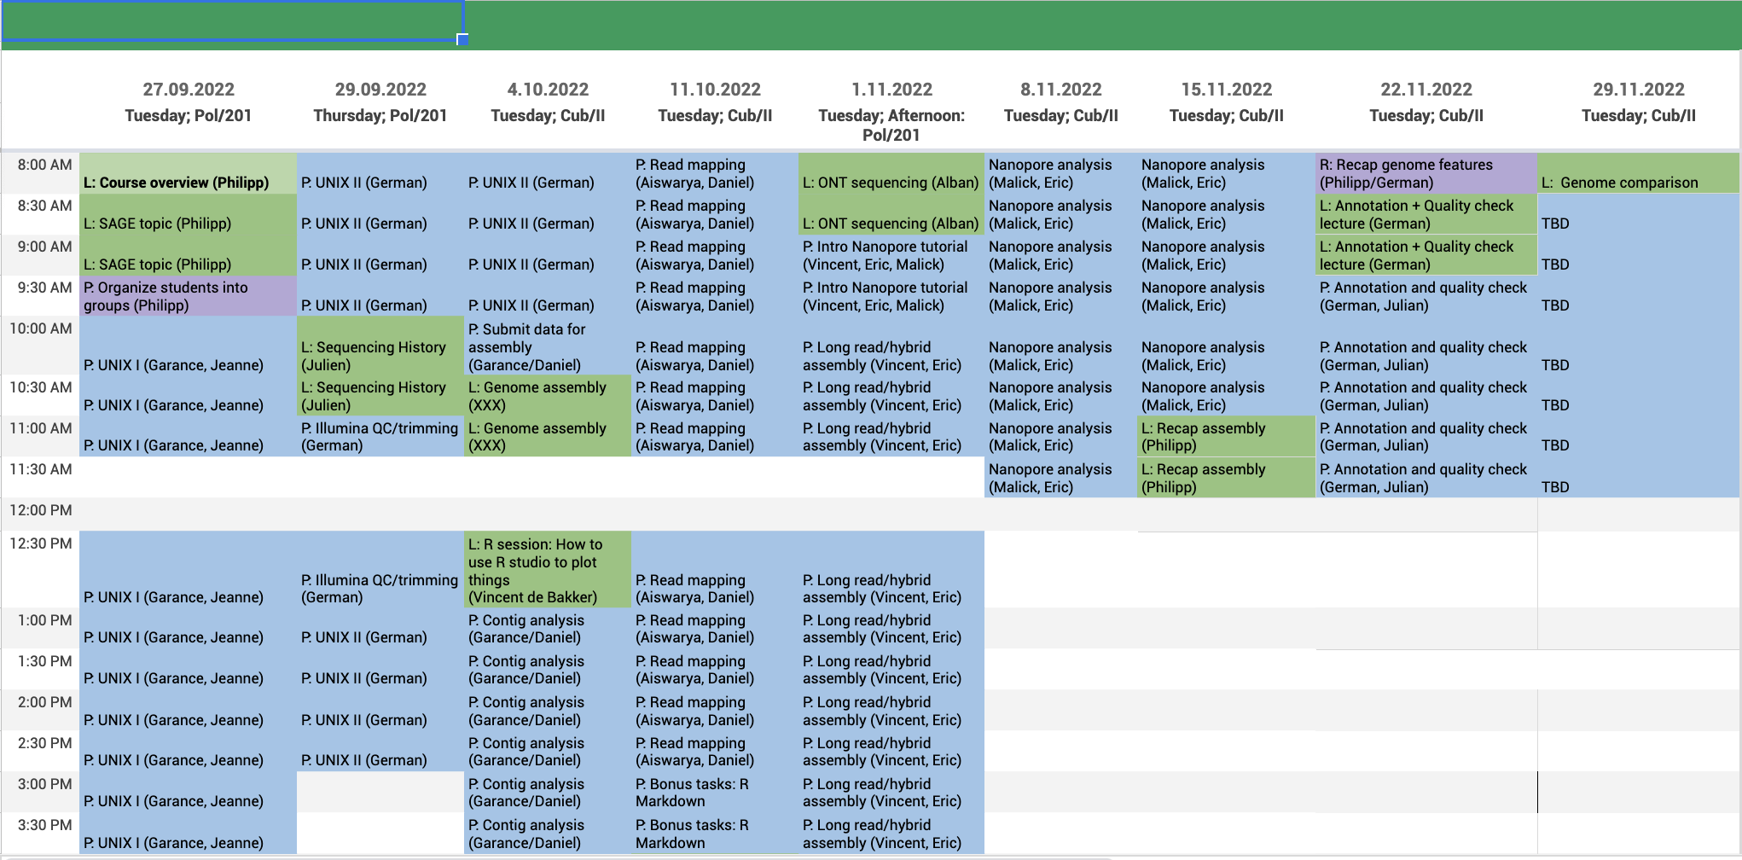

Slide 4
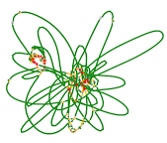
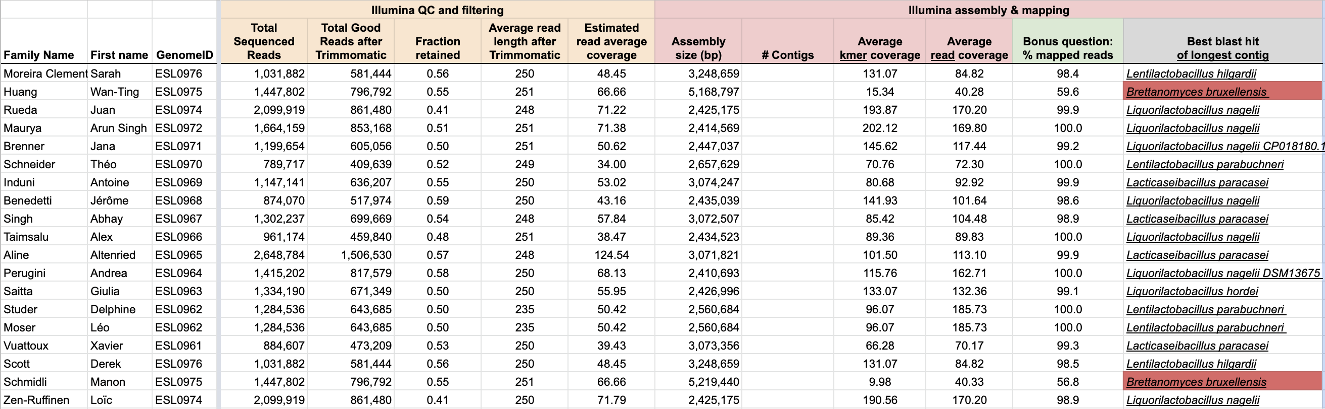
Your Illumina assemblies
Add the number of contigs to your genome
Bonus: What is the N50 of your assembly, can you calculate it?

Slide 5
Bacterial isolates from water kefir
Water kefir: A fermented, fizzy drink
Lactic acid bacteria
Yeasts
Some others
Sugars
Fermentation
Acids, alcohol
https://revolutionfermentation.com/

Slide 6
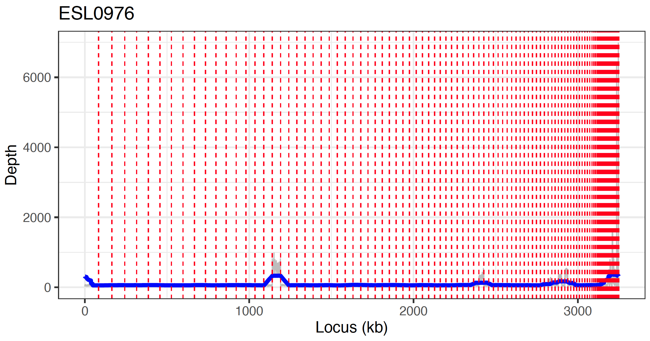
Assemblies are fragmented, i.e. consist of different contigs

Slide 7
Draft genome or fully assembled genome?
Our Illumina genome assemblies = Draft genome
Draft genomes → several contigs with gaps in-between
Complete genomes → one contig (or several contigs) without gaps
Option 1:
Option 2:
Illumina draft genomes
Nanopore/PacBio sequencing
Published genomes:
286’625 genomes
Complete genomes:
20’714
Complete genome
Genome annotation
Genome annotation
Genome analysis
Genome analysis
https://www.ncbi.nlm.nih.gov/genome/browse#!/prokaryotes/
Publication
Publication

Slide 8
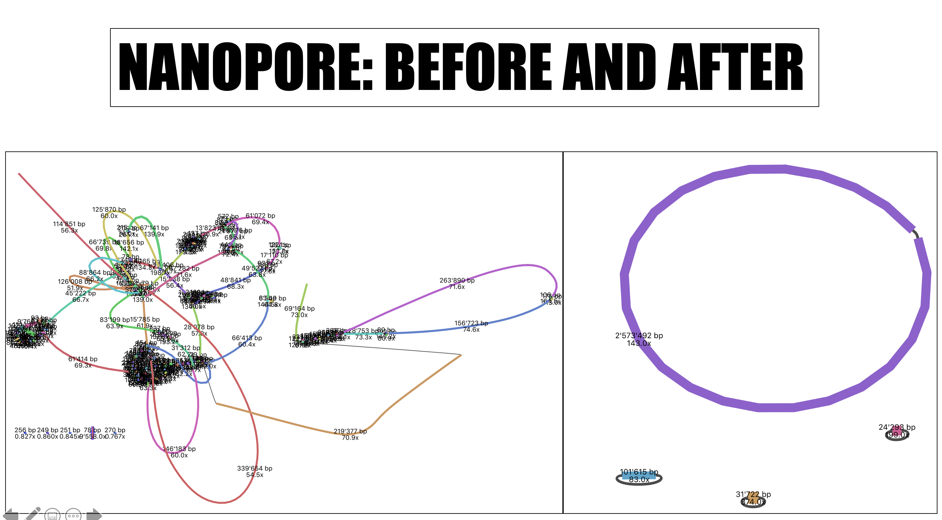
From draft to complete genomes...
Illumina assembly
ONT/PacBio assembly
Many contigs
Not clear how connected
One contig per circular replicon
Chromosome and plasmids

Slide 9
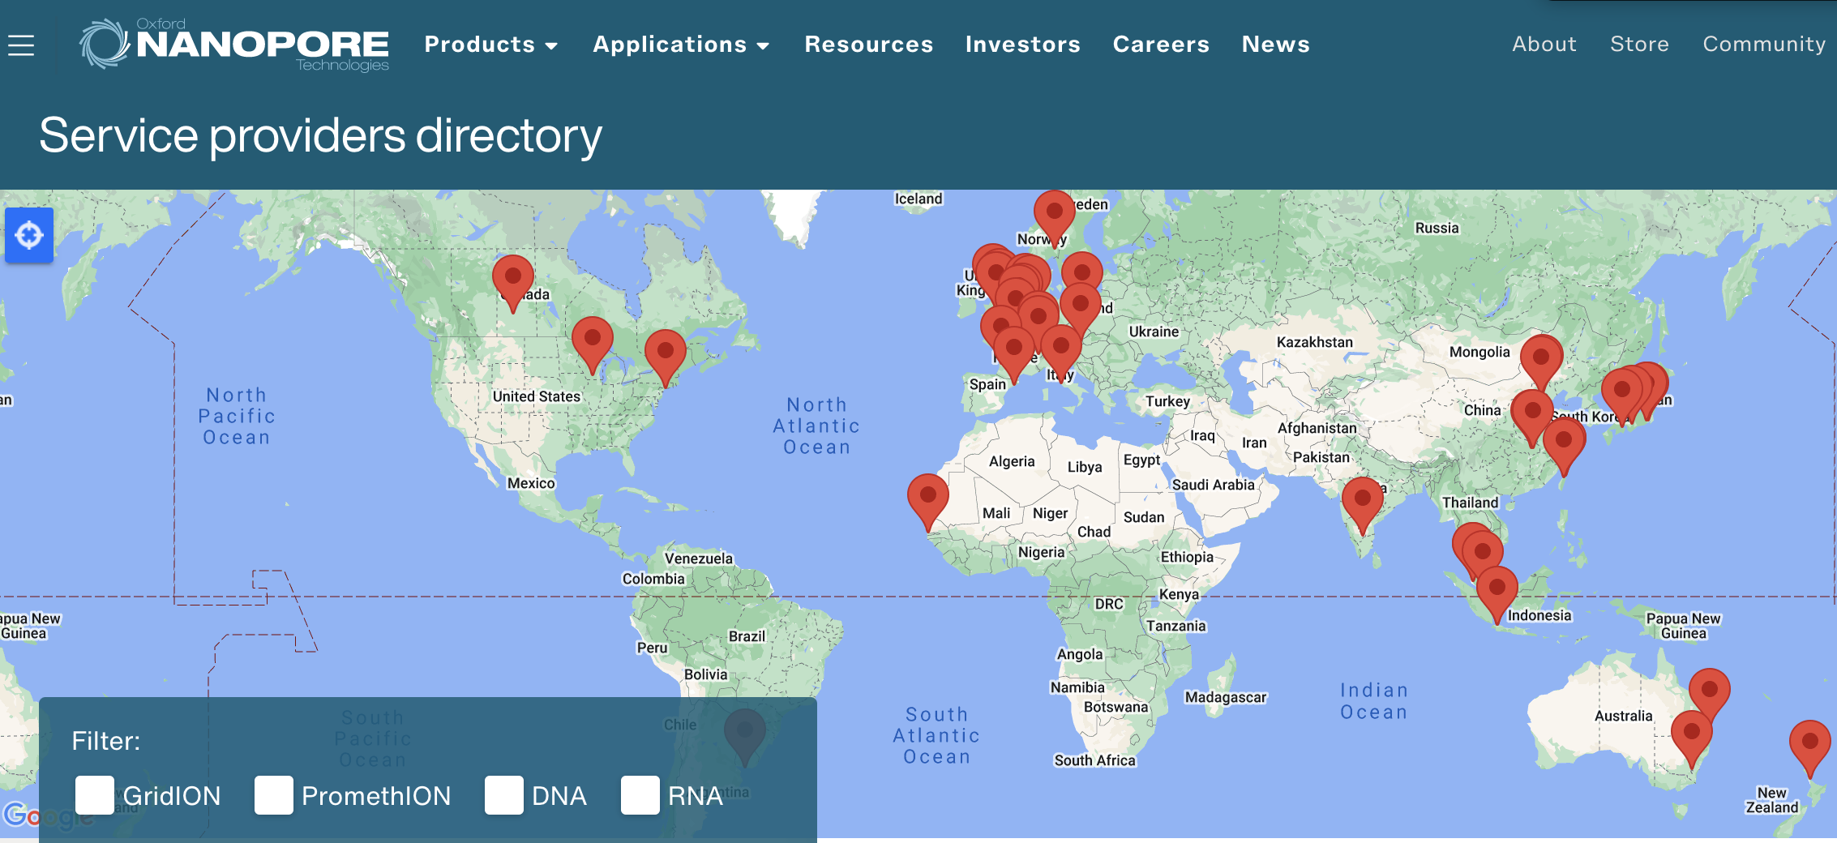
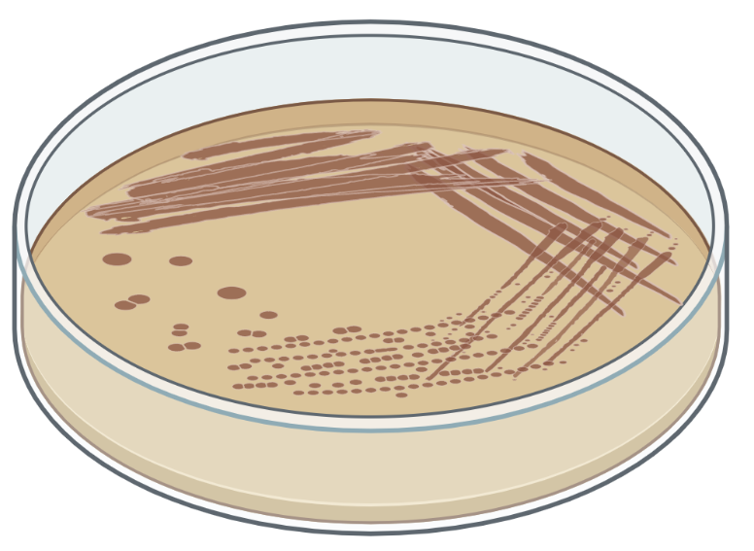
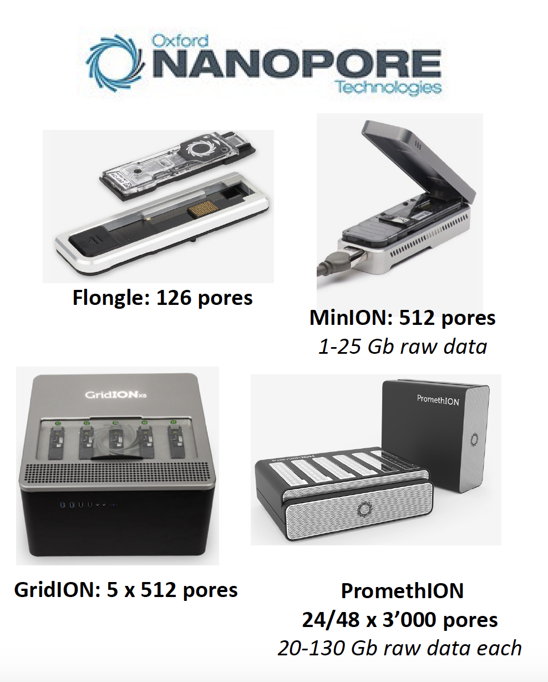
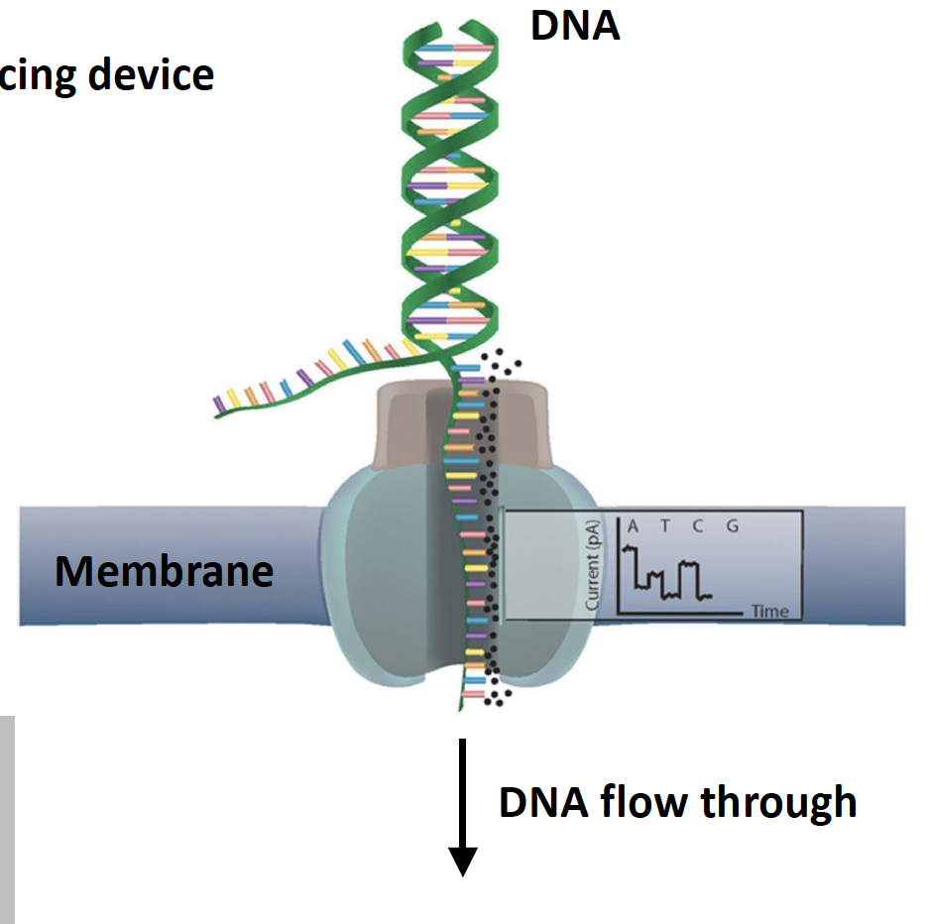
We have acquired ONT long reads for our bacteria
Re-grew bacterial isolate
HMW DNA isolation
Sent DNA to Alban Ramette (Ifik, UniBe)

Slide 10
Today’s program
Lecture by Alban Ramette about ONT sequencing
Break
Introduction to ONT tutorial
Long read QC and filtering
Long-read assembly
‘Advanced’ R coding: Learn to use variables and loops

